Slide 1
Secure data hiding in images using steganography
CAPSTONE PROJECT
Presented By:
Student Name : Rindhiya G
College Name & Department : A.V.C College of Engineering & B .Tech(IT)

Slide 2
OUTLINE
Problem Statement
Technology used
Wow factor
End users
Result
Conclusion
Git-hub Link
Future scope

Slide 3
Problem Statement
Traditional data encryption methods make it obvious that sensitive information is being transferred. This project focuses on hiding data within images using steganography, making communication secure and undetectable. The goal is to develop a system that ensures confidentiality and integrity of data while keeping it hidden from unauthorized access.

Slide 4
Technology used
Programming Language: Python
Libraries: OpenCV, Steganography Modules
Platform: Jupyter Notebook / PyCharm
Encryption Algorithm: LSB (Least Significant Bit) method

Slide 5
Wow factors
✅ Enhanced Security: Hidden data remains undetectable without proper decryption. ✅ Minimal Data Distortion: The image quality remains almost unchanged after data embedding. ✅ User-Friendly Interface: Simple GUI for encoding and decoding messages. ✅ Versatility: Can be used for text, images, or even small files.

Slide 6
End users
🔹 Government Agencies: Secure communication of sensitive information. 🔹 Journalists & Whistleblowers: Safe information transfer without detection. 🔹 Cybersecurity Professionals: Research and implementation of secure data exchange. 🔹 General Users: Protecting personal and confidential messages.

Slide 7
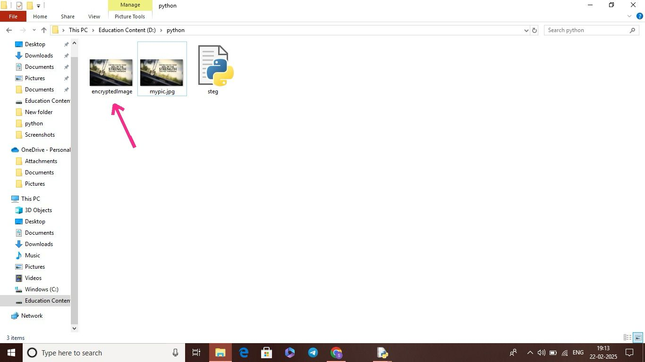
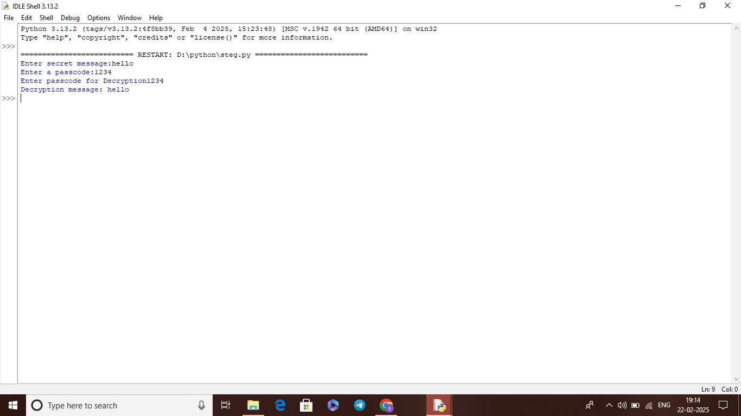
Results

Slide 8
Conclusion
.
This project successfully implements image steganography to securely hide data within images using Python and LSB techniques. The system provides a robust method for secure and undetectable data transfer, making it highly useful in cybersecurity and confidential communications.

Slide 9
GitHub Link
https://github.com/Rindhiya123/stego.git

Slide 10
🚀 Support for Audio & Video Steganography 🚀 Enhanced Encryption Algorithms for Better Security 🚀 Cloud-Based Implementation for Large-Scale Use 🚀 Mobile App Development for Easy Access
Future scope(optional)

Slide 11
THANK YOU

